Slide 1
Cybercrimes
Dr. Iftikhar Alam
CUSIT

Slide 2
Cont…
The increased adoption of digital technology has caused an evolution in criminal behavior, resulting in the increased occurrence of ‘cybercrime’.
Origin
Alternative terminology for cybercrime includes, for example, ‘cyberspace crime’; ‘computer crime’; ‘computer-related crime’; ‘electronic crime’; ‘e-crime’; ‘technology-enabled crime’; ‘high-tech crime’.
Definition
‘Cybercrime’ encompasses a wide number of acts, crimes or illicit conduct perpetrated by both individuals or groups against computers, computer-related devices, or information technology networks, as well as traditional crimes that are facilitated or maintained by the use of the internet and/or information technology

Slide 3
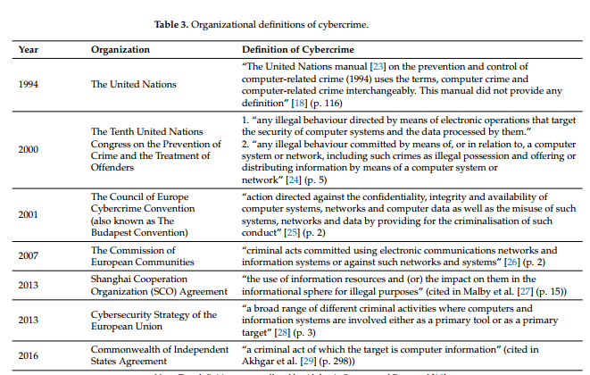
Organizational definition

Slide 4
Cont…
‘cyber’ a buzzword as it became synonymous with almost anything related to computers and the internet, e.g., cyberspace, cybershopping, and cybersurfing.
Other alternative names are:
Computer Crimes
E-crimes
Digital crimes
Internet crimes
Tech crimes
Net crimes

Slide 5
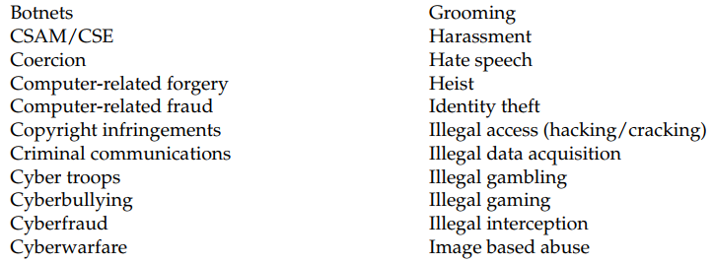


Cont…
Cybercrimes include a diverse set of offences and harmful behaviors
Botnets can be used to perform Distributed Denial-of-Service attacks, steal data, send spam, and allow the attacker to access the device and its connection.

Slide 6
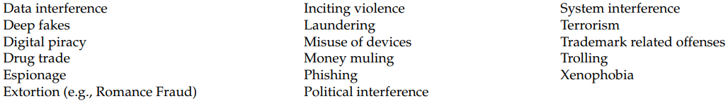
Cont…

Slide 7
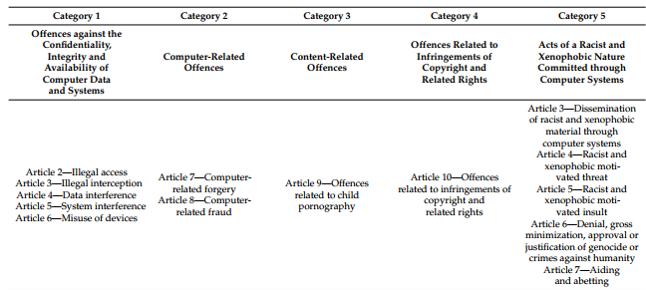
Categories (exhaustive/tentative) Table 4. Table summarizes the cybercrime typology described by The Council of Europe’s 2001 Convention of Cybercrime (also known as The Budapest Convention) with the addition of category 5 in 2003.

Slide 8
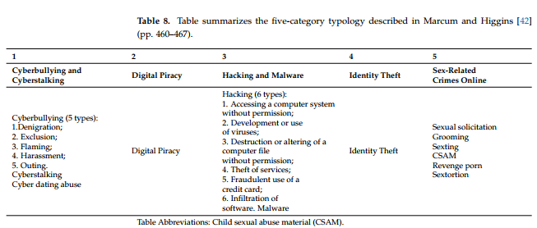
Other categories

Slide 9
Random assignment
https://eur-lex.europa.eu/eli/dir/2013/40/oj
https://www.coe.int/en/web/cybercrime/home
https://rm.coe.int/1680081561

Slide 10
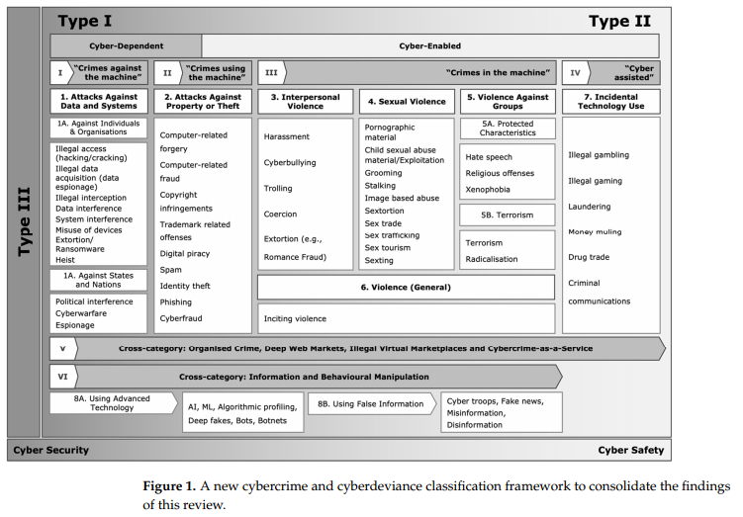
Classification

Slide 11
Cybercrime Laws
Cyber crime act 2016..
Still a gap
Today, cyber crime laws are still poorly worded or simply don’t apply to the types of crimes being investigated.

Slide 12
End of lecture

